Slide 1
Homework H1.1
Most Popular ML Technologies + Products
Presented by
Richard Mader, Noah Bross, Sinan Yurttadur

Slide 2
Content
Quick Introduction of the 3 Technologies + Products
IBM Watson ML
Microsoft Azure ML Studio
Google Cloud ML Plattform
Learnings

Slide 3
Machine Learning Technologies/ Products
IBM Watson ML – Sinan Yurttadur
Microsoft Azure ML Studio – Noah Bross
Google Cloud ML Plattform – Richard Mader

Slide 4
This is IBM Watson ML
Cloud service
Run machine-learning models anywhere, across any cloud.
Ist Open AI
easy to use interface for build, manage, train and deploy models
https://www.ibm.com/cloud/machine-learning

Slide 5
Deployment options
Watson ML Cloud
deploy and run your model in the IBM Cloud
Watson ML Server
deploy and run your model in any cloud
https://www.ibm.com/cloud/machine-learning

Slide 6
Functions
AutoAI
One-Click deployment
Model operations
Intergrated UI end-to-end
deploy any model at scale
dynamic retraining
https://www.ibm.com/cloud/machine-learning

Slide 7
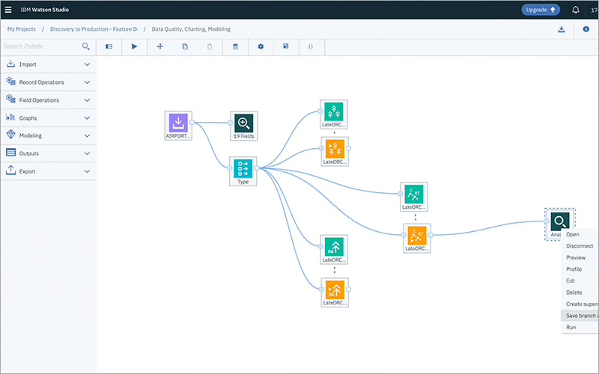
Product Image
https://www.ibm.com/cloud/machine-learning

Slide 8
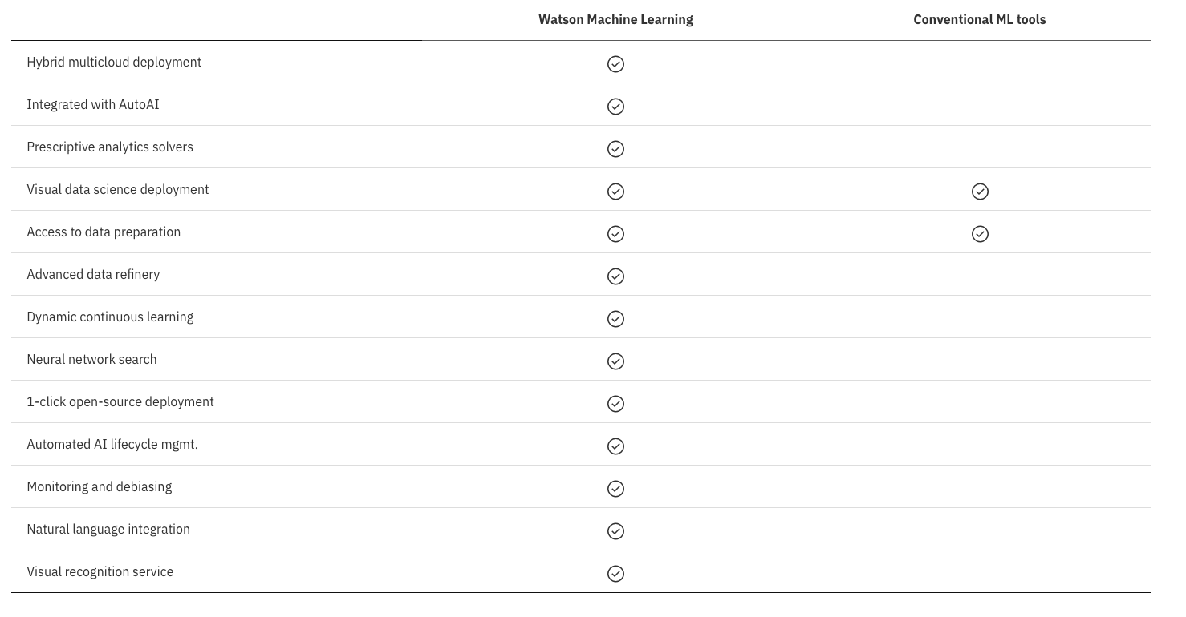
Compare IBM ML
https://www.ibm.com/cloud/machine-learning

Slide 9
This is Azure Machine Learning Studio
Cloud Service -> Machine Learning as a Service
central tool for data scientists & developer
interface for build, manage, train and deploy models
https://azure.microsoft.com/de-de/services/machine-learning/#faqs

Slide 10
Functions
Automatic scaling of resources
Connection to Microsoft ecosystem (PowerBI, database ...)
Possibility to integrate open source RL algorithms & frameworks
Beginners (drag and drop) and expert-friendly
Automated MLAutomated creation of classification, regression and time series forecast
Ability to understand how a model was created
https://azure.microsoft.com/de-de/services/machine-learning/#capabilities

Slide 11
Use Case
computer vision
forecasting
text analysis
hardware acceleration

Slide 12
Tooling & Language
Visual Studio Code
Visual Studio
PyCharm
Jupyter
Python
R

Slide 13
Frameworks
MLflow
Kubeflow
ONNX
PyTorch
TensorFlow
…

Slide 14
Interesting
The Studio supports around 100 methods that address classification (binary+multiclass), anomaly detection, regression, recommendation, and text analysis. It’s worth mentioning that the platform has one clustering algorithm (K-means).
https://www.altexsoft.com/blog/datascience/comparing-machine-learning-as-a-service-amazon-microsoft-azure-google-cloud-ai-ibm-watson/

Slide 15
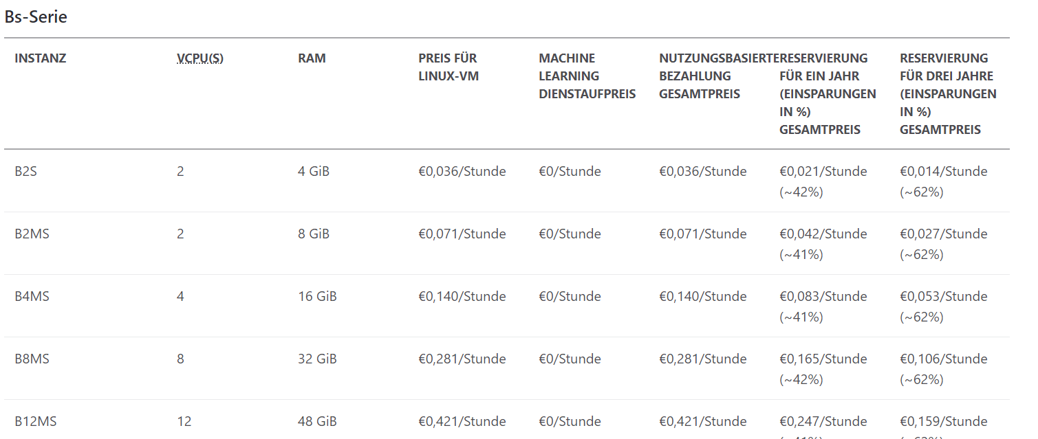
Pricing
https://azure.microsoft.com/de-de/services/machine-learning/#pricing
Notes:
Azure Machine Learning | Microsoft Azure

Slide 16
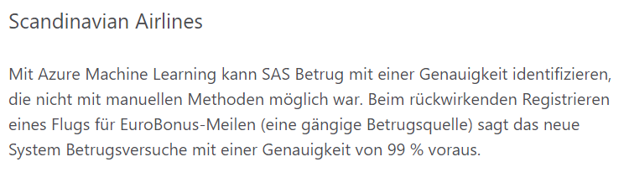
Example 1
https://azure.microsoft.com/de-de/services/machine-learning/#customer-stories
Notes:
Azure Machine Learning | Microsoft Azure

Slide 17
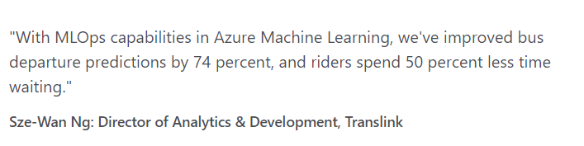
Example 2
https://azure.microsoft.com/de-de/services/machine-learning/#customer-stories

Slide 18
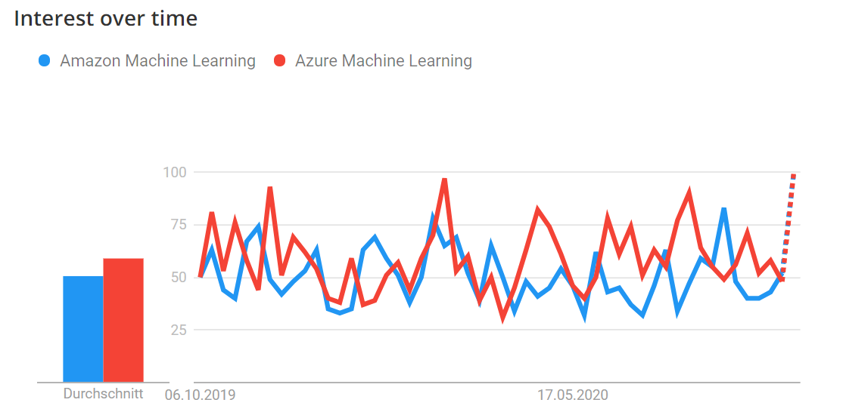
Popularity
https://stackshare.io/stackups/amazon-machine-learning-vs-azure-machine-learning

Slide 19
This is Google Cloud AI-Platform
Infrastructure for Machine-Learning
Tools & accompanying services

Slide 20
Training service
Train on Google's hardware
Own or integrated algorithms
Store training data in Google Cloud

Slide 21
Forecast service
Host models in the cloud
Own models can also be operated

Slide 22
Pipelines
Automation of ML tasks
Prepare data
Train
Evaluate
Deployment

Slide 23
Notebooks
Jupyterlab in the Google Cloud
Suitable hardware can be selected

Slide 24
Data Labeling Service
Labeling of records as a service
Pictures, videos & text

Slide 25
Use Case
Cloud console
"Gcloud" CLI
Rest API

Slide 26
Direct Compare of the Technologies
Download compare.pdf for more informations
https://drive.google.com/file/d/1u4S4xrq9WkFHbKhNaqTX-M6hW0BmWqOc/view?usp=sharing

